Slide 1
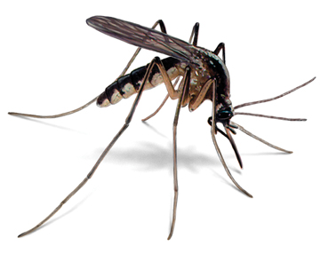

Risk Assessment Map System for Zika (RAMS)
May 2016
Owen Hsu and Brinda Monian
936

Slide 2
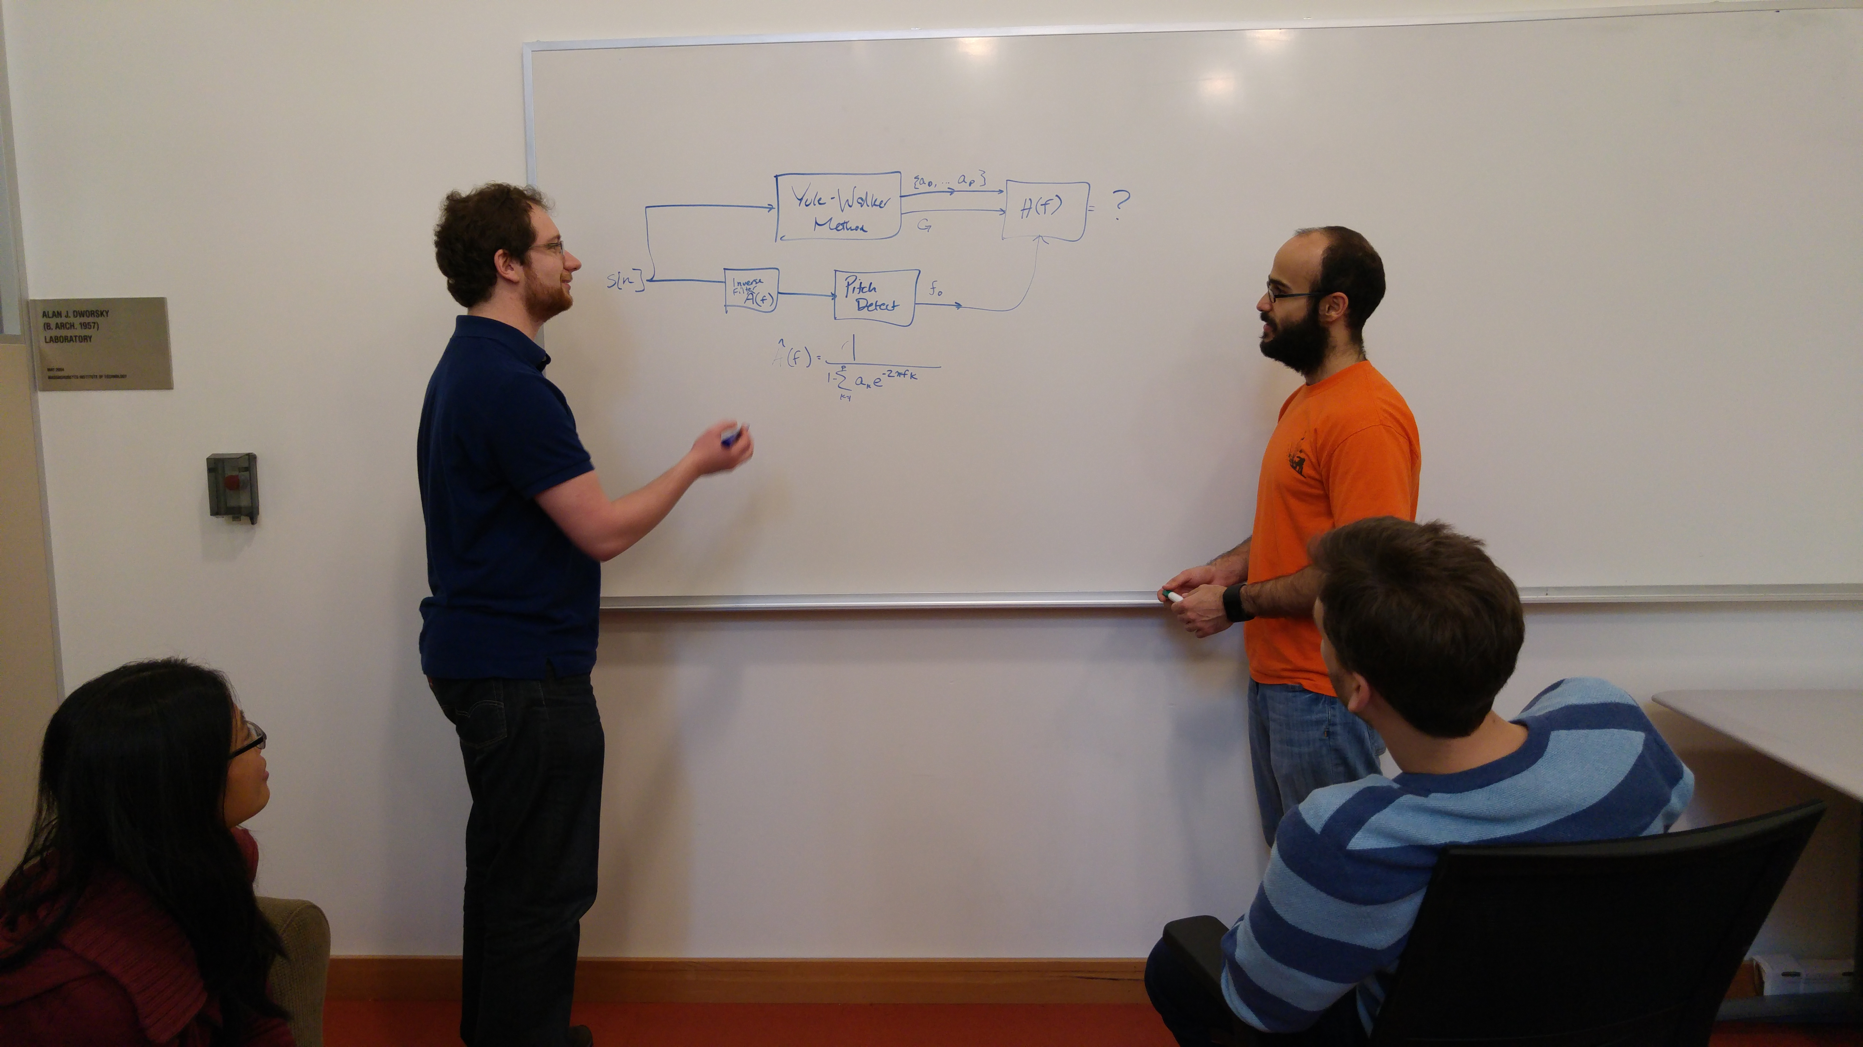
Motivation
Unmet Needs:
Knowledge of high-risk areas for Zika infection
Knowledge of patient symptoms indicative of Zika infection
Accurate diagnosis of Zika
Plan:
Design an app for data collection of patient demographics and symptoms
Upload the data into a database
Analyze the data to find high-risk zones as well as demographic information that correlates with disease prognosis
Integrate this information into future generations of the app for more accurate diagnosis and treatment of Zika

Slide 3

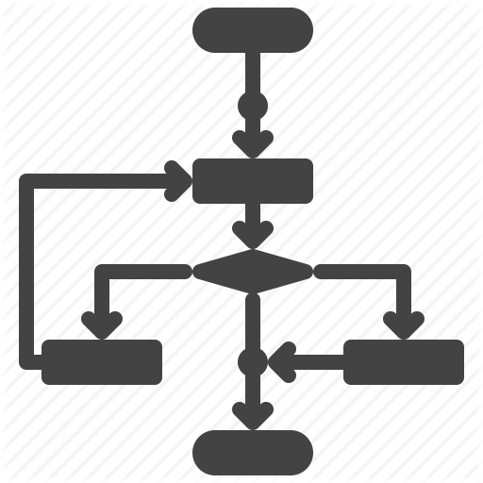
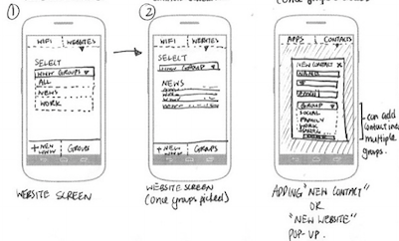



Development Flow
1
User Operation Behavior
2
Operation Flow
3
Function List
4
Wireframe
5
Programming
6
Testing

Slide 4






Tools
Platform to apply Google Map API
Google Map API
Android APP Development Platform
Web Server
Database

Slide 5
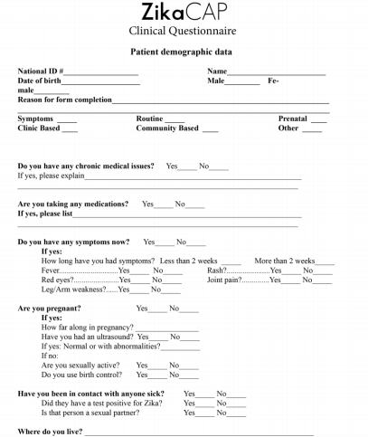
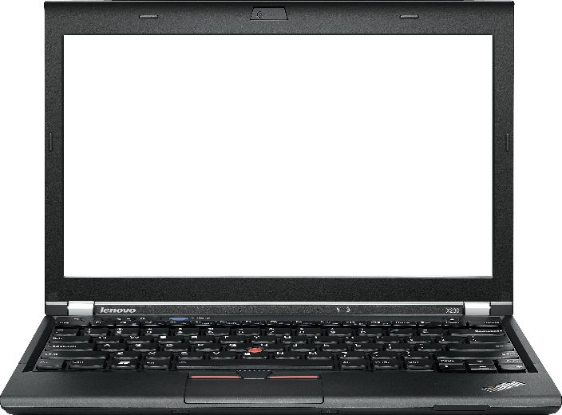
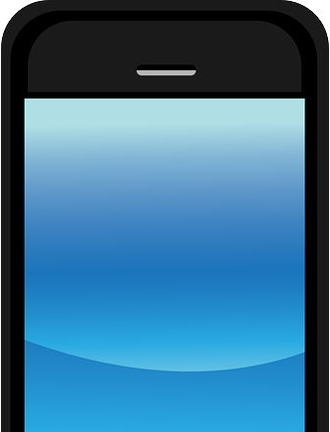
Tools
Digitalize the form to collect clinical data when Zika-suspected patient arrives at a hospital
Care provider records their data by laptop or smartphone
Name
Date of Birth
/
/
Location
Name
Date of Birth
/
/
Location

Slide 6

Data Storage & Analysis
Upload all clinical data to a database:
Clinical endpoints
Patient demographics
Symptoms
Subject ID | Gender | Date of Birth | Location | … | Fever | Red eyes | Joint pain | … | Status at follow-up visit
Use supervised learning approaches to correlate patient demographics and symptoms to clinical endpoints:
Risk $=f(x1,x2,x3…xn)$

Slide 7
Outcome #1: More accurate diagnosis, enabled by pilot data analysis
Clinical endpoints
Patient demographics
Symptoms
Subject ID | Gender | Date of Birth | Location | … | Fever | Red eyes | Joint pain | … | Status at follow-up visit
Enter patient information
App returns risk analysis
Name
Date of Birth
Risk of Zika virus:
80%
/
/
Location
Fever?

Slide 8
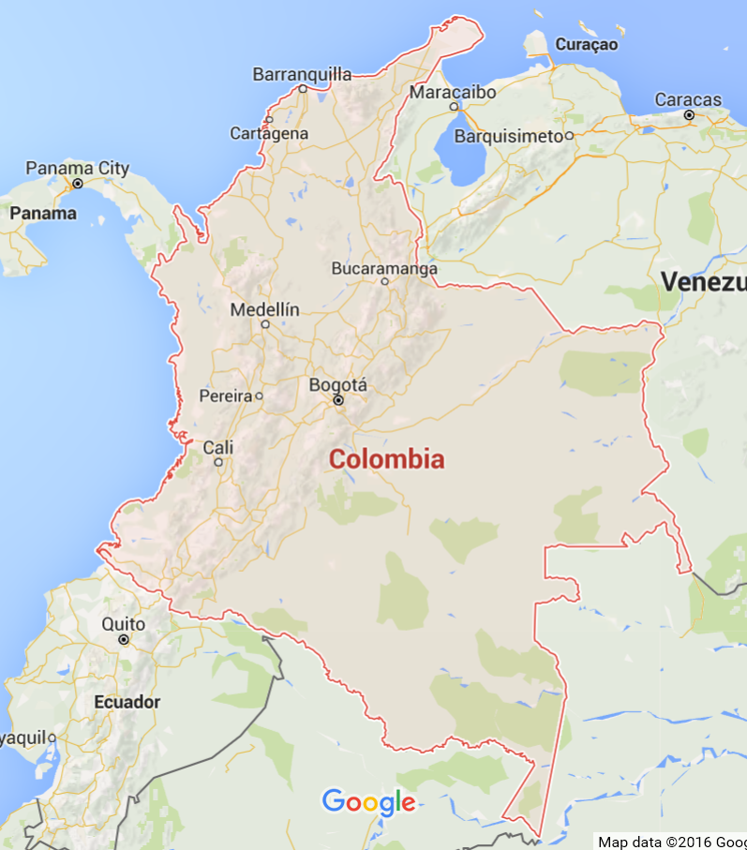
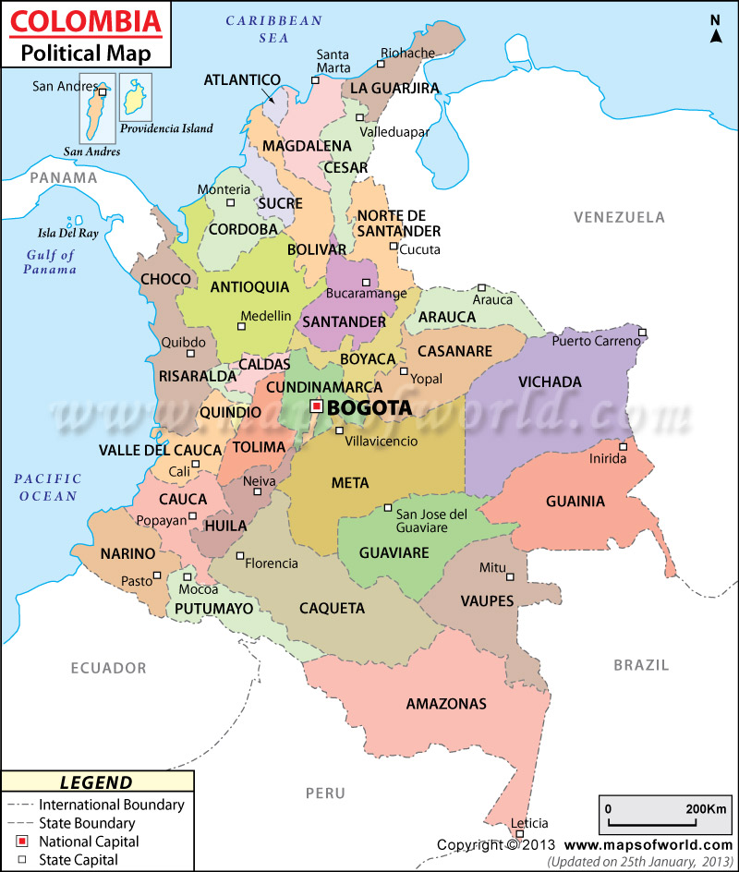
Outcome #2: Map of high-risk zones;
this information could be integrated into
future generations of the app
Display the risk by APP
on smartphone
Red circle represent to the level
of risk of Zika, dengue fever
…etc

Slide 9
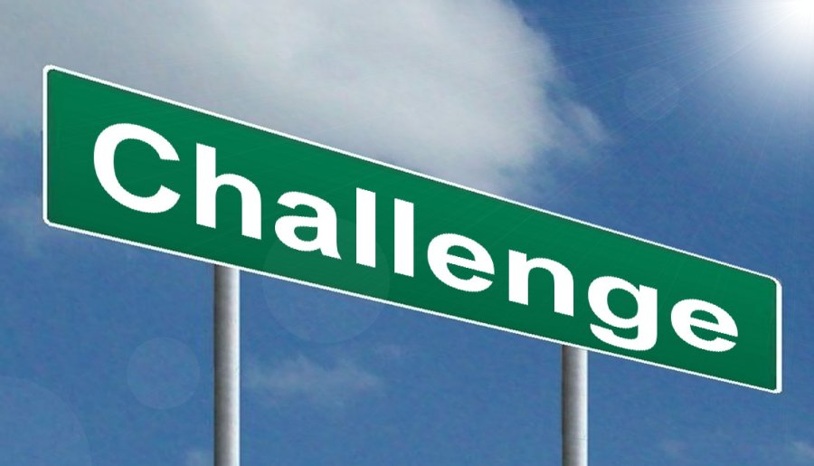
Anticipated Challenges
Patient location data might be hard to obtain accurately and in a standardized way, especially in rural settings
Correlation of patient data with clinical outcome may be difficult because follow-up data could be missing for some patients
An app designed strictly for data collection might be challenging to get buy-in from clinicians and health workers
Incidence of Zika might be short-lived or sporadic; difficult to collect large amounts of reliable data

